Slide 1
NIIT Technologies
Camel Training Project Assignment Tasks - Showcase

Slide 2
Agenda
Application Architecture
Component Architecture
Features (Transaction/Logging/Api-Documentation/Unit Testing)
Demo

Slide 3
Application Architecture
Get Order Rest API
Port:8091
Rest
SQL
ELK
Soap API Gateway
Port:8092
http4
Post Order Rest API
Port:8095
Rest
JPA
H2:
Order DB
Router
cxf
http4
AMQ
SQL
Active MQ
Queue://Order
Queue://ordernotify
SQL
Order Processor &Notification
Port:8094
http4
Put Order Rest API
Port:8093
AMQ
Rest
AMQ
File://ordersimulator
SQL
File://orderproces
File Storage

Slide 4
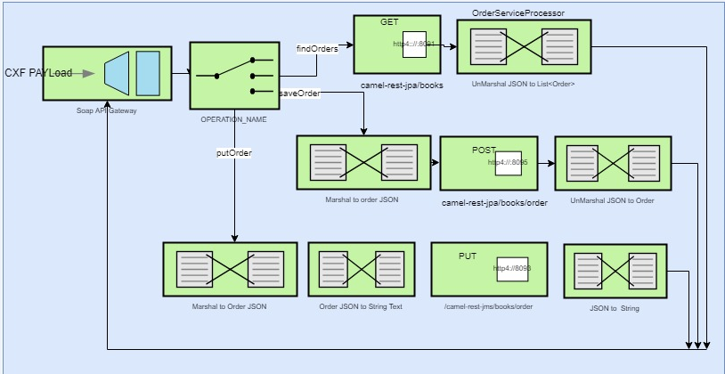
Component Architecture - SOAP API Gateway

Slide 5
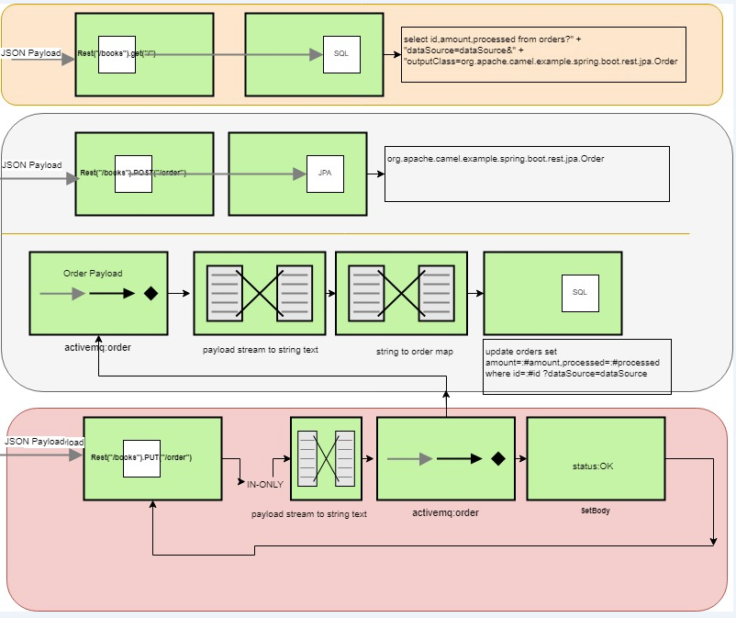
Component Architecture – Get/Post/Put Order API

Slide 6
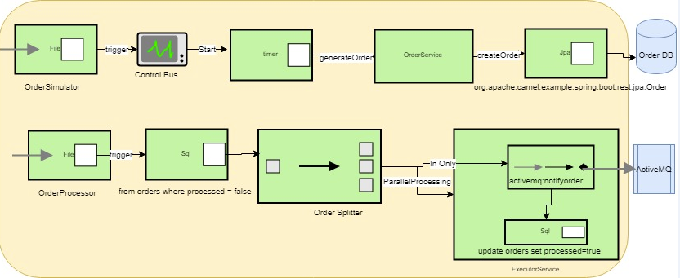
Component Architecture – Order Processor and Notification Service

Slide 7
Demo
http://localhost:8095/swagger/index.html - post (new) order
http://localhost:8091/swagger/index.html - get order
http://localhost:8093/swagger/index.html - put(update) order
http://localhost:8094 –Notification(Parallel order processor)
http://localhost:8092/service/apigateway?wsdl – soap gateway wsdl
http://localhost:8161/admin/queues.jsp - Active MQ(D:\sw\apache-activemq-5.11.1\bin\activemq start), admin/admin
http://192.168.252.186:8082/login.do - h2 console(jdbc url: jdbc:h2:~/testdb), login: sa
mvn spring-boot:run -Dlog4j.debug
http://localhost:9200/ - Elastic Search (D:\sw\elk\elasticsearch-6.3.2\bin elasticsearch)
Logstash: cd D:\sw\elk\logstash-6.3.2 , call bin/logstash -f config/camel.conf
http://localhost:5601/app/kibana - Kibana (D:\sw\elk\kibana-6.3.2-windows-x86_64\bin kibana)

Slide 8
Demo Continued.. (Technology Stack)
Eclipse STS : D:\sw\sts-bundle\sts-3.9.0.RELEASE
Workspace: D:\projects\odcameltraining\camelTrainingWS
Active MQ: D:\sw\apache-activemq-5.11.1
ELK: D:\sw\elk\elasticsearch-6.3.2, D:\sw\elk\kibana-6.3.2-windows-x86_64, D:\sw\elk\logstash-6.3.2
H2 DB: D:\sw\h2-setup-2018-03-18.exe
Maven: D:\sw\apache-maven-3.5.4
JDK 8
SpringBoot 2.0.4
Camel 2.23.0.x
Camel Training Project Repo: https://github.com/ashvanisr/odcameltraining

Slide 9
Demo Continued..
Payload Structure
<soapenv:Envelope xmlns:soapenv="http://schemas.xmlsoap.org/soap/envelope/" xmlns:ser="http://server.wsdlfirst.cxf.examples.notsoclever.cc/">
<soapenv:Header/>
<soapenv:Body>
<ser:saveOrder>
<!--Optional:-->
<ser:arg0>
<amount>5001</amount>
<!--Optional:-->
<book>
<!--Optional:-->
<description>test desc</description>
<id>5</id>
<!--Optional:-->
<item>4</item>
</book>
<id>3467</id>
<processed>false</processed>
</ser:arg0>
</ser:saveOrder
</soapenv:Body>
</soapenv:Envelope>
{
"id":1,
"amount":1500,
"book":{"id":1,"item":"Camel","description":"Camel in Action"},
"processed":false
}

Slide 10
Demo Continued..
Order Processor and Notification Service
Triggering OrderSimulation : Drop file to this location
File Location:
D:\projects\odcameltraining\camel-example-spring-boot-notification-gateway\src\main\resources\OrderSimulation
Triggering OrderProcess : Drop file to this location
File Location:
D:\projects\odcameltraining\camel-example-spring-boot-notification-gateway\src\main\resources\OrderProcess

Slide 11
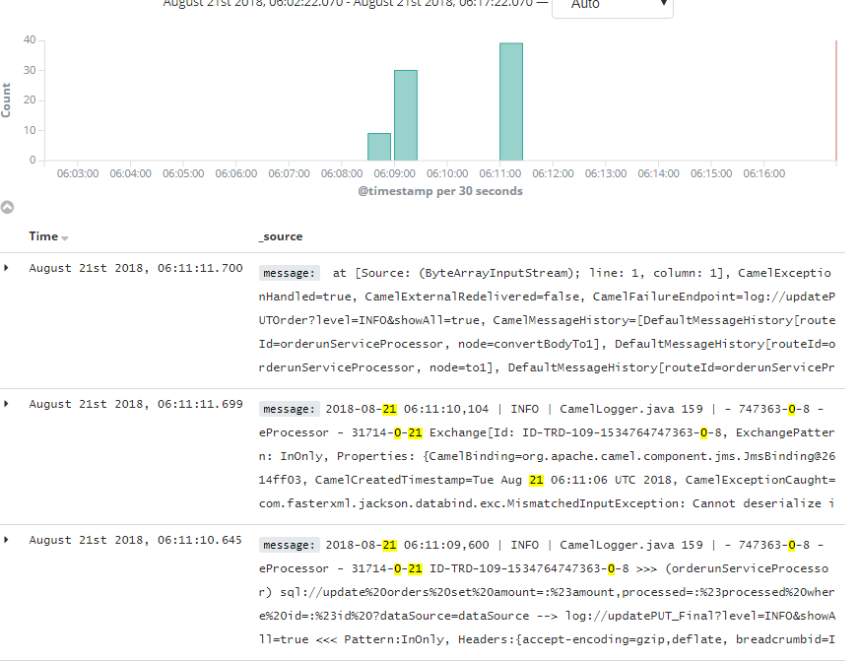
Logging: MDC
Log Location: D:\projects\logs\postGateway.log
MDC: camel-example-spring-boot-rest-jpa-sql-post-gateway: log4j.properties, Pattern: %d | %p | %F %L | - %-10.10X{camel.exchangeId} - %-10.10X{camel.routeId} - %-10.10X{camel.breadcrumbId} %m%n
context.setUseMDCLogging(true);
Log Information
2018-08-17 09:33:51,477 | INFO | OrderServiceProcessor.java 48 | - 257997-0-1 - route1 - 257997-0-1 saveOrderProcessor **********************:
2018-08-17 09:33:51,477 | INFO | OrderServiceProcessor.java 48 | - 257997-0-1 - route1 - 257997-0-1 saveOrderProcessor **********************:
2018-08-17 09:33:51,484 | INFO | OrderServiceProcessor.java 56 | - 257997-0-1 - route1 - 257997-0-1 saveOrderProcessor called with: 3000
ELK:
Filters
Message: Exchange
Exception
Error
Logstash Config:
camel.conf

Slide 12
Transaction Management
Application : D:\projects\camel_jdbc_transactions
Run: mvn camel:run
//handle exceptions and log them
onException(IllegalArgumentException.class).
maximumRedeliveries(0)
.handled(true)
.to("log:rollBackLogs")
.beanRef("accountService", "dumpTable")
.to("file:target/messages?fileName=deadLetters.xml&fileExist=Append")
.markRollbackOnly();
//our route definition
//noop option - if true, the file is not moved or deleted in any way
from("file:src/data?noop=true")
//mark the route as transacted
.transacted()
//execute spring bean methods
.beanRef("accountService","credit")
.beanRef("accountService","debit")
.beanRef("accountService","dumpTable")
//log the result
.to("log:ExampleRouter");

Slide 13
Unit Testing
Application : D:\projects\odcameltraining\springboot-camel
@RunWith(CamelSpringBootRunner.class)
@SpringBootTest
@DirtiesContext(classMode = ClassMode.AFTER_EACH_TEST_METHOD)
@DisableJmx(true)
public class MyRouteQuartzRouterTest extends CamelTestSupport {
@EndpointInject(uri = "direct:teststart")
private ProducerTemplate endpoint;
@Override
protected void doPostSetup() throws Exception {
context.getRouteDefinition("MyRouteID").adviceWith(context, new AdviceWithRouteBuilder() {
@Override
public void configure() throws Exception {
replaceFromWith(URI_START_ENDPOINT);
weaveAddLast().to("mock:end");
}
});
context.start();
}
@Test
public void shouldSucceed() throws Exception {
MockEndpoint mock = getMockEndpoint("mock:end");
mock.expectedMessageCount(1);
template.sendBody(URI_START_ENDPOINT,in);
mock.assertIsSatisfied();
}

Slide 14
Thank You

